Slide 1



Tactical Detection & Data Analytics Summit
Save the Date: December 4-11 Scottsdale, Arizona
sans.org/summit
SEC455 - SIEM Design & Implementation
SEC599 – Defeating Advanced Adversaries
SEC530 – Defensible Security Architecture
SEC555 – SIEM with Tactical Analytics
SEC511 – Continuous Monitoring & Security Operations
SIEM NetWars
SUMMIT
Dec. 4-5
TRAINING
Dec. 6-11
sans.org/summit
Notes:
Drag Picture and Send to Back

Slide 2
SEC530
Defensible Security Architecture and Engineering
Protect your Lunch Money Keeping the Thieves at Bay
Justin Henderson (GSE # 108) and Ismael Valenzuela (GSE # 132)
@SecurityMapper @aboutsecurity

Slide 3


About Us
Justin Henderson
SEC555 Author / SEC455 and SEC530 Co-Author
GSE #108 / Cyber Guardian Blue + Red / 60 certs
Owner of H & A Security Solutions
Twitter: @SecurityMapper
Ismael Valenzuela
SEC530 Co-author / SEC503 and SEC511 Instructor
GSE # 132 and also a certification master
Sr. Principal Engineer at McAfee
Twitter: @aboutsecurity

Slide 4
Welcome!
A copy of this talk is available at: https://github.com/HASecuritySolutions/presentations
More free stuff: https://github.com/HASecuritySolutions

Slide 5

All Round Defender
Being an all round defender means you are the person responsible for:
Network Security
Routers / Switches / Software defined networking
Flow data
Firewalls / IDS and IPS / Sandboxing
Cloud Security
Hypervisors and central management
Infrastructure/Platform/Software/Function (as-a-Service)
Endpoint Security
Antivirus / Whitelisting / HIPS / EDR / Patching / Hardening / Logging / dare I go on?
Plus all the things that cross boundaries like data governance and identify management

Slide 6
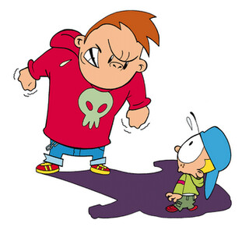
Bullies and the Cyber Realm
Bullying is a great analogy for cyber security
Fighting back gets you in trouble
Bully often is:
Bigger / “bad-er”
Rulebreaker
Overconfident
Organization’s hope they are not the target…

Slide 7
Dealing with a Bully
Couple options for dealing with a bully
Aim for invisibility and hide
Have an authority figure catch them in the act
Get them in trouble via their ignorance and arrogance
Each of these translates well into cyber capabilities

Slide 8

Option # 1 – Going Invisible
If an bully cannot see you then you are safe
Like Harry Potter’s cloak of invisibility
In cyber defense we can go invisible
Host-based Firewalls
Mutual TLS
IPSec

Slide 9
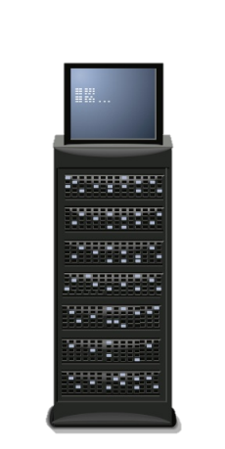



Trust Model Change
Computer authentication is often one-way
Example: SSL/TLS
Client connects to TLS site and authenticates server
Client is commonly not verified
Yet SSL/TLS support mutual authentication
web.sec530.com
pc1.sec530.com

Slide 10
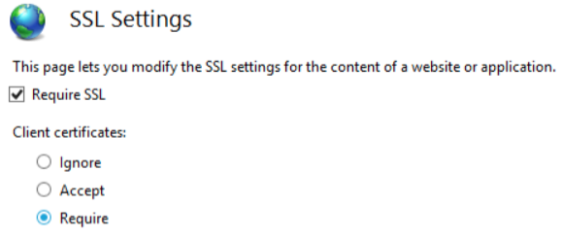
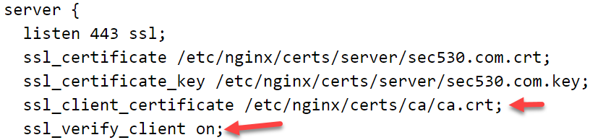
Client Certificates
Enabling mutual authentication requires simple change
May just require clicking a radio button
Or adding some text to a configuration file
Requires clients to have certificates and a CA

Slide 11
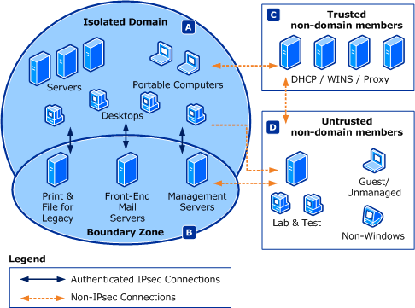
Windows Domain Isolation
Windows natively supports IPSec for domain isolation
Blocks unauthorized non-domain access
Authenticates all traffic
Mutually authenticated
Optionally encrypts traffic
Cannot attack the invisible
Mitigates man-in-the-middle
Lowers service exploitation risk

Slide 12
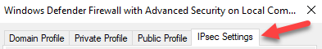
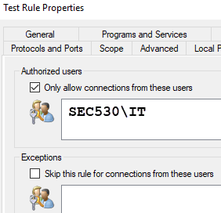
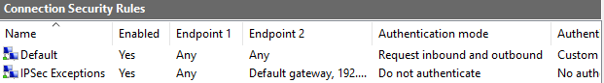
Windows IPSec
IPSec integration is part of the Windows Firewall
Change IPsec default options (recommended)
Default does not mandate encryption for ESP
Requires Connection Security Rules
Granular control via firewall rules

Slide 13
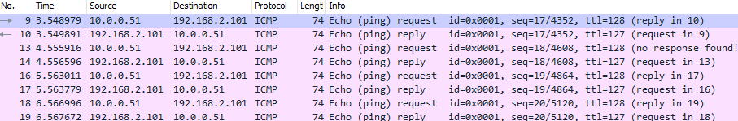
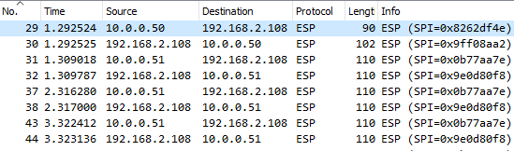
Windows Ping Example
Without IPSec
With IPSec

Slide 14

Option # 2 – Monitor for Bully
Multiple ways to “catch” a bully in the act
Part 1 we spoke of Network Security Monitoring
Other methods include:
Running scripts
Security Information and Event Management (SIEM)
Endpoint Monitoring

Slide 15
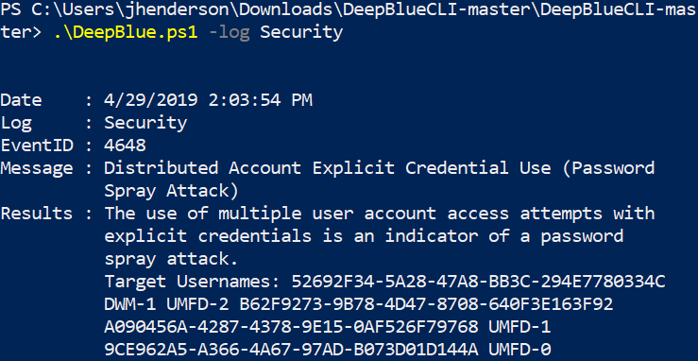
DeepBlueCLI

Slide 16






Security Information and Event Management (SIEM)
What is a SIEM used for?
Centralized log collection
Advanced alerting
Systems automation
Analysis system
Compliance repository
Big data analytics platform
Threat intelligence
SIEM != log collection
It can do so much more

Slide 17
Log Enrichment
query: www.google.com
query: www.google.com
subdomain: www
parent_domain: google
registered_domain: google.com
creation_date: 1997-09-15
tags: top-1m
geo.asn: Google Inc.
frequency_score: 18.2778256342
parent_domain_length: 6
Enriches to this

Slide 18
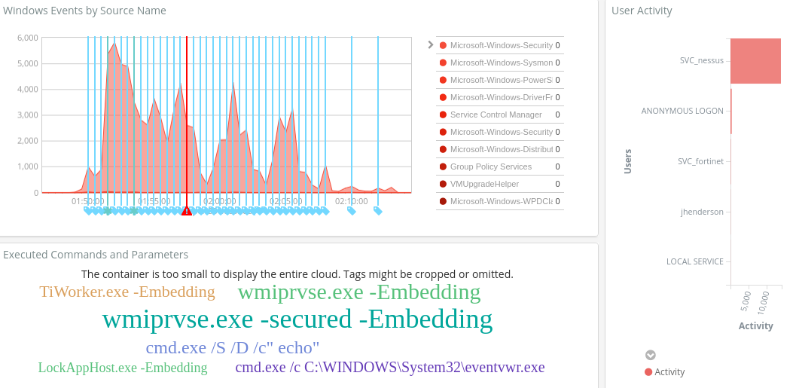
SIEM Monitoring

Slide 19
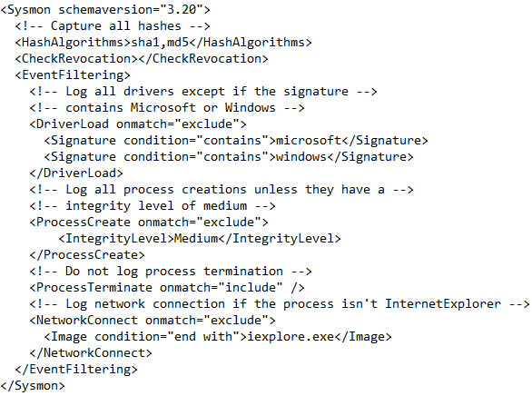
Endpoint Monitoring
Sysmon, from Microsoft Sysinternals, can provide ‘visibility’ on:
Processes (inc. hashes)
Network connections
Driver and DLL loading
Raw disk access
Modifications of file creation times
Process access
https://github.com/SwiftOnSecurity/sysmon-config

Slide 20

Sigma
Writing new rules per SIEM is reinventing the wheel
Fortunately, Sigma exists to fill the gap
Written by Florian Roth & Thomas Patzke
"To logs, what Snort is to network traffic and YARA is to files"
High level generic language for analytics
MISP compatible - share and store aligned with threat intel
Decouples rule logic from SIEM vendor and field names
Eliminates SIEM tribal knowledge

Slide 21
Option # 3 – Outsmart the Bully
Bully may get into trouble because of overconfidence
Turning in homework with wrong answers
As if you are not as bright as bully thinks
Stealing food that tastes bad
Fruits and vegetable diet
Similar to making you “unworthy” of bullying

Slide 22
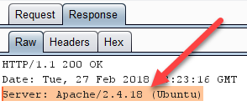
Service Banners
Many applications identify their software and version number upon connection
Attackers and malware use information for exploitation
Possible to change version, application, or OS identification
May be sufficient to break automated attack tools and scans
Implemented at the local server or with a reverse proxy
Alternative is to hide or limit information
May break automated attacks
But less effective

Slide 23
Minimizing Service Banners
Services may natively support hiding or limiting service information
Apache uses ServerTokens directive
ServerTokens Full (Full or OS default for Apache)
Apache 2.4.18 (Ubuntu) PHP/7.2.2
ServerTokens OS
Apache/2.4.18 (Ubuntu)
ServerTokens ProductOnly (banner with least info shown)
Apache

Slide 24




Detection Capabilities
Meaning of detection based on attack source and destination
External - Early detection of external threat
Expected true positives (may occur so much as to be noise)
Internal - Early detection of insider threat
Low false positives and true positives (high fidelity alert)
Rewrites banner as: Microsoft/IIS 8.5
Web Server Running: Apache 2.4.18

Slide 25
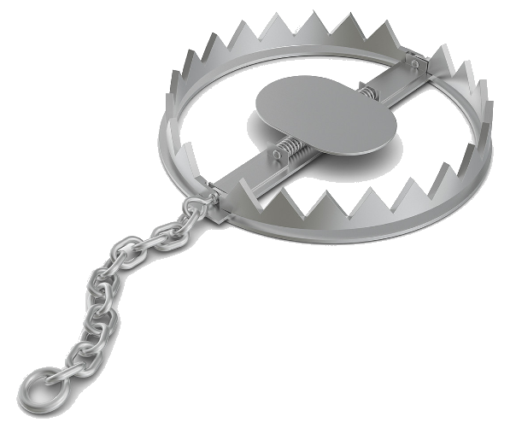
Honeytokens
Fake objects or content is helpful for identifying unauthorized activity
Fake objects or content is referred to as a Honeytoken
Sometimes referred to as a Canarytoken
Implementation requires data placement and logging
Credit card excel sheet with file auditing
Web bug links with web server's logs
SQL record with stored procedure logging

Slide 26
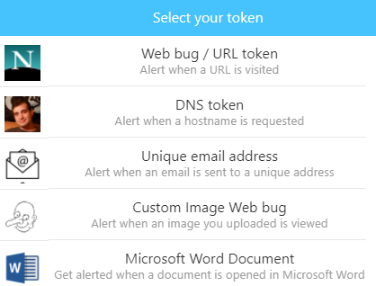
CanaryTokens.org
Thinkst offers a free token service at canarytokens.org
Thinkst also provides commercial honeypot solutions
GUI wizards provides walkthrough
Takes minutes to deploy a token
Wizard supports unique monitors
Detect website being cloned
Alert if AWS key is used
Identify if custom binary executed
Monitor folder being browsed

Slide 27
Summary
Multiple ways of dealing with bullies (attackers)
Aim for invisibility and hide
Firewalls, Mutual TLS, IPSec
Have an authority figure catch them in the act
NSM, SIEM, endpoint monitoring, scripts like DeepBluCLI
Get them in trouble via their ignorance and arrogance
Honeytokens and change service banners

Slide 28


Presentation based on SEC530: Defensible Security Architecture and Engineering
Thank you!!
References
https://www.sans.org/course/defensible-security-architecture-and-engineering
Notes:
There’s a lot more we could talk about... Check out SEC530.

Slide 29
Tactical Detection & Data Analytics Summit
Save the Date: December 4-11 Scottsdale, Arizona
sans.org/summit
SEC455 - SIEM Design & Implementation
SEC599 – Defeating Advanced Adversaries
SEC530 – Defensible Security Architecture
SEC555 – SIEM with Tactical Analytics
SEC511 – Continuous Monitoring & Security Operations
SIEM NetWars
SUMMIT
Dec. 4-5
TRAINING
Dec. 6-11
sans.org/summit
Notes:
Drag Picture and Send to Back

